Slide 1
Contemporary Challenges in Customized Communication
Dr. Maurits Kaptein
m.kaptein@donders.ru.nl
Notes:
Info: 30 mins
Abstract: The effective personalization of messages (in communication) or treatments (in medicine) has been a topic of research for decades. However, recent technological advances in measurement opportunities, such as wearable sensors, have a large impact on effective personalization methods. Furthermore, methodological research on estimating causal treatment effects has taken in big flight in recent years. In this keynote Dr. Maurits Kaptein will give an overview of the classical scientific and applied methods of treatment personalization, and will highlight novel opportunities. Specifically, Maurits will detail methods to personalize treatments based on behavioral observations that arrive continuously. Methods for sequential treatment allocations and the estimation of causal effects will be discussed and accompanied by practical examples. The keynote aims to highlight the contemporary challenges in effective treatment personalization.
Hi, I am Maurits Kaptein (very brief intro / work on Persuasion Profiling / work on methods for large-scale customization)

Slide 2
Customization
Personalization, Tailoring, …
Notes:
We are here together with the best national academic scholars and those on the forefront of industry in the customization of communication. Welcome ;)
Extremely important area of study: we know that not every messages is equally effective for every recipient: we can make communication more effective by selecting “the right message for the right person at the right time”. This can increase the effectiveness of public campaigns, health-care communication, and advertising
But, it is of even larger importance: we are effectively studying methods of selecting treatments (although we coin them messages) for individuals (we coin them recipients). Effective methods to pair treatments with recipients to reach a desired result are well sought for in many branches of social science: psychiatrist look for the best interventions for their patients, physicians customize medication, teachers personalized educational programs, etc. etc.
And we are in a great position to propel this field forward. Those studying communication, and especially digital communication, can for the first time study the effect of treatments on large groups of recipients over prolonged periods of time. In digital communication we have opportunities to measure the effects of our messages that were unheard of 15 years ago. We have the ability to manipulate treatments that is still unheard of in neighboring fields. Thus, we can be at the forefront of not only making communication more effective, but developing the methods that will broadly be used in the social sciences to customize treatments at a large scale. It is an exciting time and place!
However, despite this promise, we have to be honest that there are substantial challenges that face us. While “selecting the right message at the right time” sounds trivial, it isn’t at all in practice. The general methods to do so are only just starting to emerge. In this talk I will try to highlight some of the challenges we face when trying to customize communication at a large scale. To do so I will first define effective customization and highlight the need for such a definition; I believe currently many demonstrations of the effect of customization do not actually demonstrate what they aim to demonstrate because of lack of common definition. Then, I will try to highlight what I feel are the most important challenges in days to come.

Slide 3

Message
Sender
Receiver
Notes:
So, let us start with defining customization; what exactly are we talking about?
The rough definition that I am going to stick to is actually quite simple: We have a sender, who sends a message to a receiver, and the message has some goal that can potentially be measured.

Slide 4
Message
Receiver
Sender
Message’
Receiver’
Notes:
So, let us start with defining customization; what exactly are we talking about?
The rough definition that I am going to stick to is actually quite simple: We have a sender, who sends a message to a receiver, and the message has some goal that can potentially be measured.
We know, even if just by our own personal experiences, that not every receiver responds in the same way to every message. Hence, for the sender to reach her goal, it might potentially be useful to select distinct messages for each recipient. Hence, customization is simply the act of selecting the right message for the current recipient, where right is defined in terms of reaching the desired goal. Pretty straightforward isn’t it?
However, it is trickier in practice. There is an obvious need to define properties of the messages, and properties of the receiver, that are useful to reach the desired goal. We don’t want to just talk about message prime and receiver prime, we want to know which features of the message and which features of the receiver relate to produce the desired goals.

Slide 5
Message
{Authority=No}
Receiver {Personality=Introvert}
Sender
Receiver’ {Personality=Extravert}
Message’
{Authority=Yes}
Notes:
Lets look at an example: We could measure recipients personality, and demonstrate that the effect of messages using an authority cue vs. those not using such a cue differ in their effect. Now we have made a first step towards concreteness (although note that we have not at all defined the effect or goal that the sender aims for!). If we sell books to introverts, we should just present the book, while if we sell books to extraverts, we should state that it is recommended by an authority, say the New York Times.
Note that it is quite clear that to customize, we need both multiple messages, as well as multiple receivers. If we only measure one receiver trait and everyone has the same score, then we cannot determine a message based on the receiver. If everyone is introvert, there is no need to personalize. Similarly, if we only have one message, there is no need to talk about customization.

Slide 6
1. Message Features
2. Receiver properties
Message
{Authority=No}
Receiver {Personality=Introvert}
Sender
Receiver’ {Personality=Extravert}
Message’
{Authority=Yes}
Notes:
Lets look at an example: We could measure recipients personality, and demonstrate that the effect of messages using an authority cue vs. those not using such a cue differ in their effect. Now we have made a first step towards concreteness (although note that we have not at all defined the effect or goal that the sender aims for!). If we sell books to introverts, we should just present the book, while if we sell books to extraverts, we should state that it is recommended by an authority, say the New York Times.
Note that it is quite clear that to customize, we need both multiple messages, as well as multiple receivers. If we only measure one receiver trait and everyone has the same score, then we cannot determine a message based on the receiver. If everyone is introvert, there is no need to personalize. Similarly, if we only have one message, there is no need to talk about customization.
Hence, to think about effective customization, we need to find properties of the message, for example using authority arguments yes or no, and properties of the receiver, for example the personality, that can be mixed and matched. So, to define customization we first need properties and features
But even if the operationalizations are clear and we have message and receiver features, then we are far away from a clear description of our customization attempt. To illustrate this consider the following…

Slide 7
Introverts respond differently to authority arguments then extraverts….
Notes:
Having message features and receiver properties is however not enough: we need to know how they relate. For example: we need to know that introverts respond differently to authority arguments. If this is not the case, then we do not need to personalize. We need to have a model of the relationship between features and properties.
We need to know: differently in what sense?

Slide 8
Introverts are more inclined to buy a book recommended by the New York Times then extraverts
Notes:
We can make the statement more specific by defining a criterium: what is the goal of our communication?

Slide 9
Introverts
effect
Extraverts
no
yes
authority
Introverts are more inclined to buy a book recommended by the New York Times then extraverts
Notes:
Many people, at first sight, think that a relation between features and properties, thus introverts respond differently to authority then extraverts, warrants customization: if this is the case we need to customize. If the authority message is more effective for introverts, and the message without the authority argument is more effective for extraverts, then we should customize.
This implies a data generating model like the one behind me on the slide.

Slide 10
Introverts
Introverts
effect
effect
Extraverts
Extraverts
no
yes
no
yes
authority
authority
Introverts are more inclined to buy a book recommended by the New York Times then extraverts
Notes:
However, it is not at all the case that a relationship between message features and receiver properties warrants customization: the relation can also be like this.
If this is the case, the there is no need to customize, since the authority message, despite having a much larger effect on introverts, is the most effective message for both types of receivers. Hence, given the effect we need to think of which message to show to which receiver. In the second case here both introverts and extraverts receive the authority message, and hence I don’t think we should call this customized….

Slide 11
Properties of the person: Personality, preferences, behavior, etc.
Features of the message: Authority arguments, font-size, channel, etc.
A goal of the communication attempt: (e.g.,) Selling more books
Model of relations between features and properties: (e.g.,) Introverts more susceptible to authority arguments
Personalization mapping: (e.g.) Introverts => Authority, Extraverts => No authority
http://link.springer.com/chapter/10.1007%2F978-3-319-20306-5_3
Notes:
Based on the example I just gave, selling books to introverts or extraverts using authority arguments yes or no, we can define all the elements of a customization attempt…
(Make explicit)

Slide 12
Challenge 1:
Feature selection
How do we find the features of the message and of the properties of the receiver that we should focus on?

Slide 13
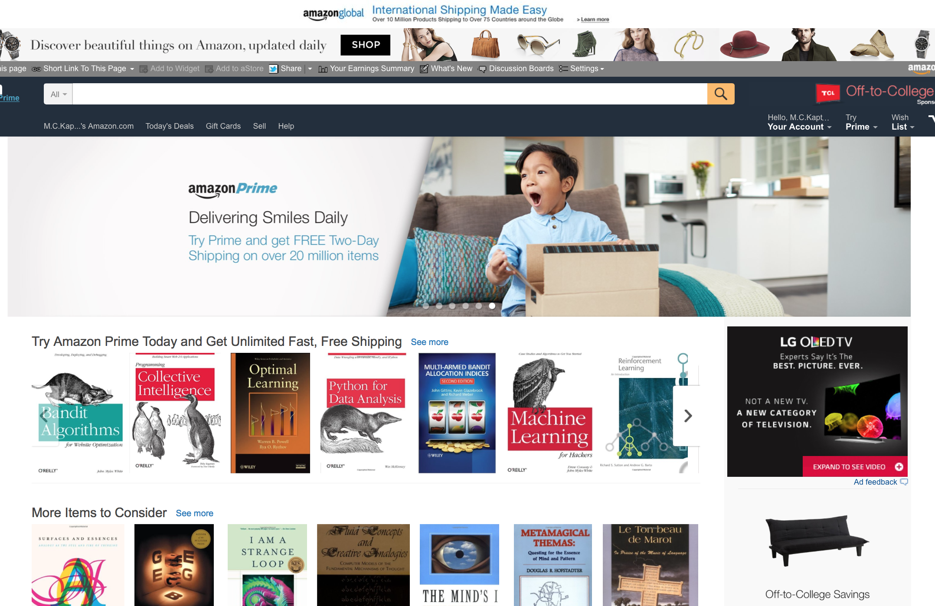

Slide 14

Notes:
Perhaps feature and property selection are domain specific

Slide 15
Opportunity: Peoples previous responses as properties.

Slide 16
Repeated exposure to persuasive messages….

Slide 17
Predicting the response to the next message:
Previous response outperforms personality measures

Slide 18
Challenge 2:
Sequential decisions
We can only learn the model gradually

Slide 19
Message A
t=1
Sender
Receiver
0
Message B
t=2
Sender
Receiver
1
Message B
t=3
Sender
Receiver
0
t=4
???

Slide 20
Exploration vs. Exploitation:
Learn new knowledge, or use what we know.
Notes:
Also known as multi-armed bandit problem.

Slide 21
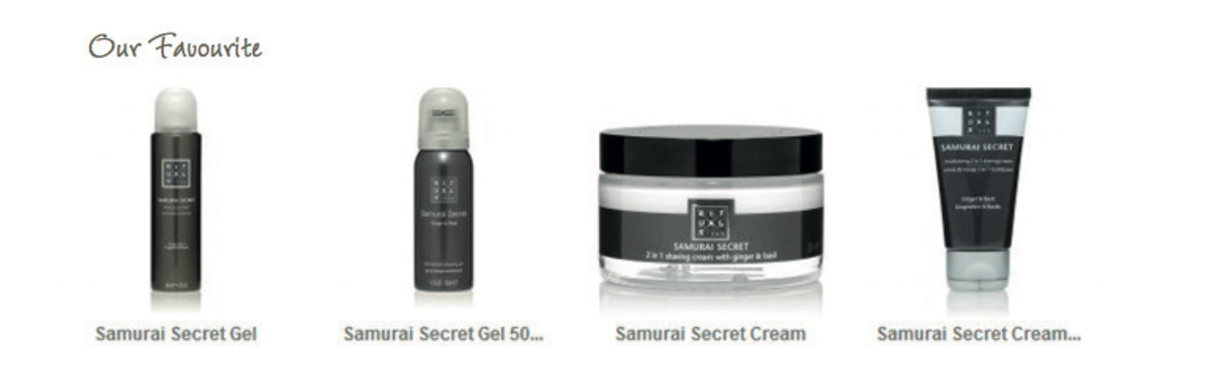
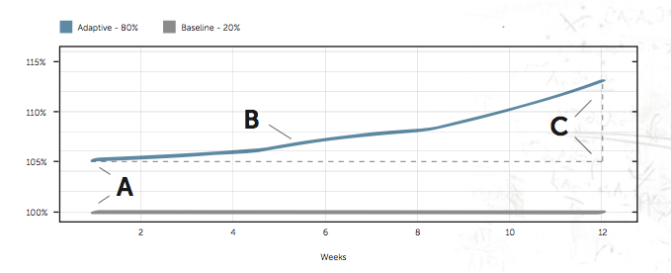
Notes:
Talk about Rituals case, using Thompson sampling (Reinforcement learning algorithm to balance exploration and exploitation).

Slide 22
Challenge 3:
Large-scale customization
How do we customizes for millions of people at the same time?
Notes:
Customizing for the millions

Slide 23
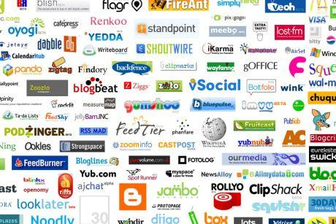
Interacting with millions of receivers….
Notes:
Technologies are being developed.

Slide 24
Possible solution: Streaming analysis
Notes:
Talk about multiple options.

Slide 25
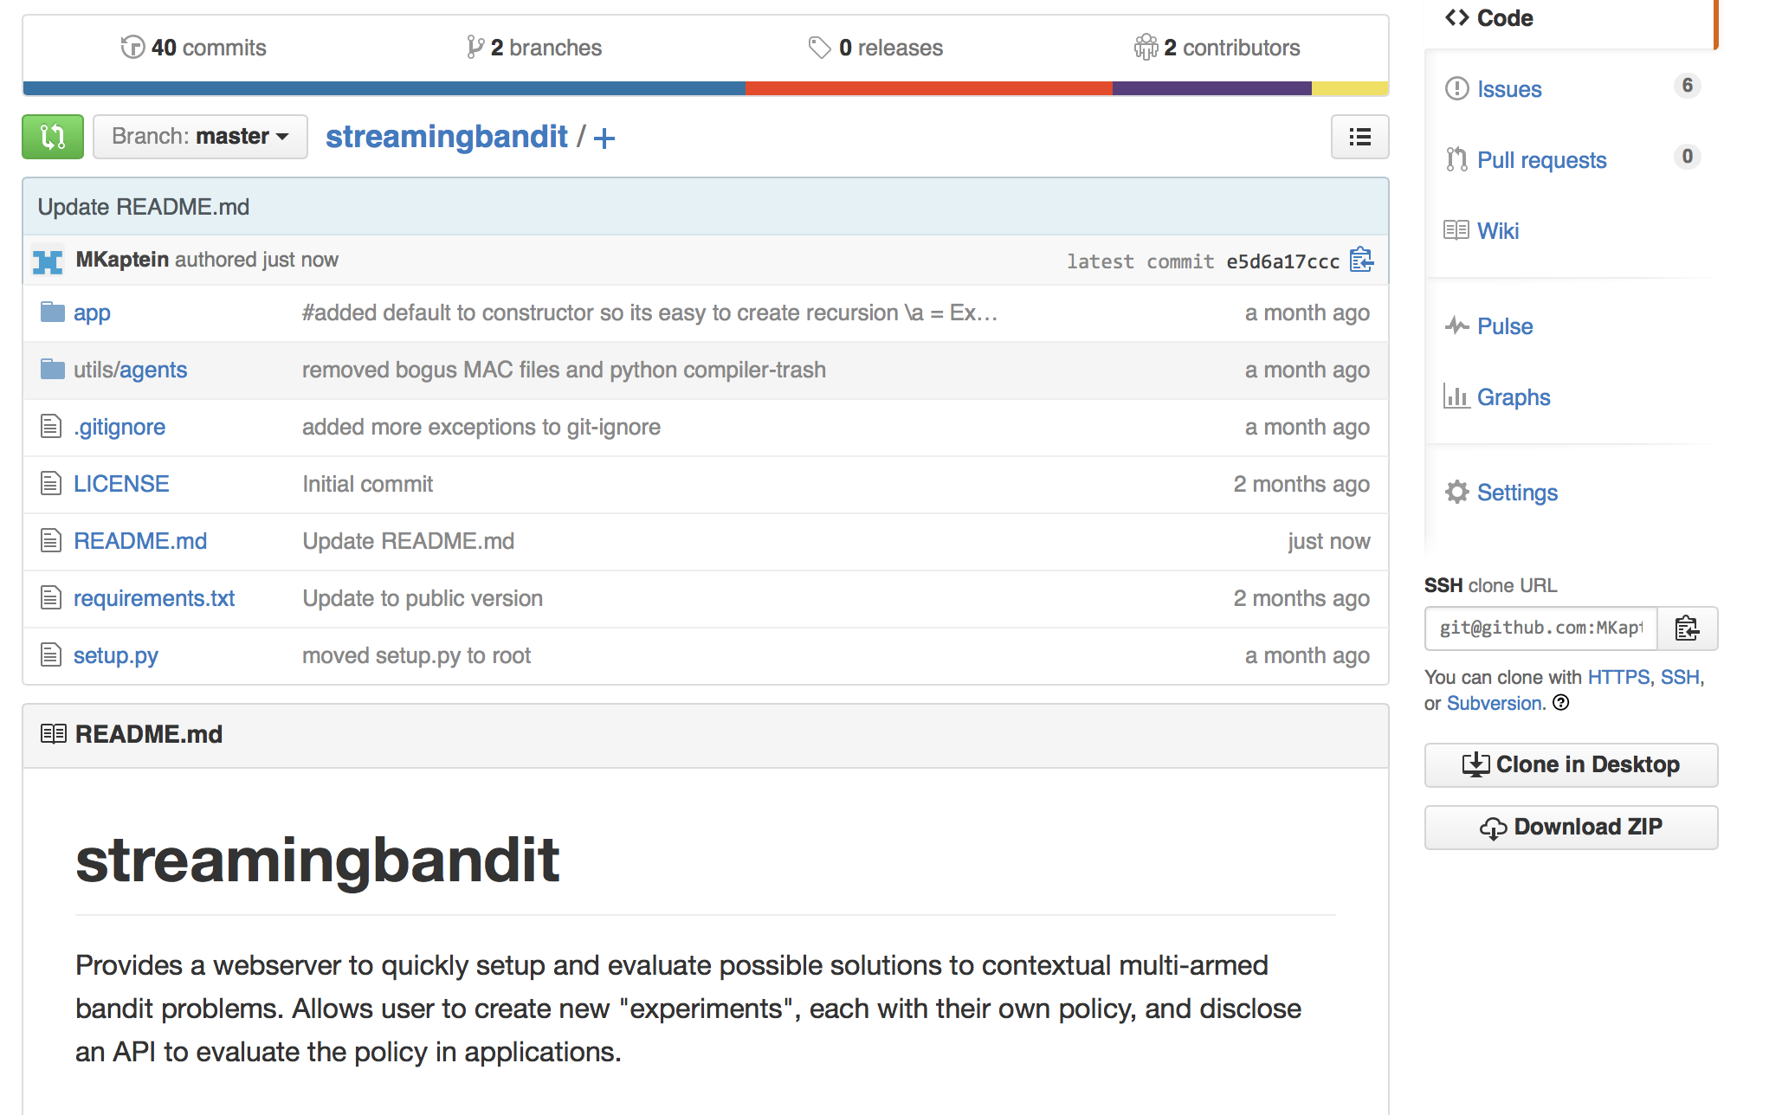

Slide 26
Challenge 4:
Ethics & Privacy
How much customization do we really want?
Notes:
Customizing for the millions

Slide 27
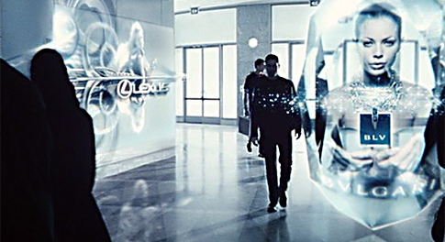

Slide 28
Possible solution: Privacy by design

Slide 29
Need for structure
Challenge 1: Feature selection
Challenge 2: Sequential interaction
Challenge 3: (Extremely) large scale
Challenge 4: Ethics & Privacy
Huge potential!
Notes:
I want to highlight that this identification of challenges is my own: these are my own opinion on what I believe are methodologically the most important challenges we face. And, I might be totally wrong: I might be missing challenges that you are facing yourself, and you might have solved some of the ones that I highlight. However, I think that is exactly why we are here together today: to discuss where we should head as a field, and to identify opportunities both in academia as well as industry to further advance customization.

Slide 30
Enjoy the afternoon!

